Slide 1
MTC : strategie

Slide 2
Welcome To MTC Technologies overview
MTC Technologies Corporation stands at the forefront of innovation in the medical device industry, with our headquarters nestled in the vibrant community of Collegeville, Pennsylvania. As a developer and seller of cutting-edge medical devices, our mission is to enhance surgical outcomes and streamline healthcare delivery.

Slide 3
Production Excellence
Each week, our facilities come alive as we manufacture over 7,200 goods, meticulously assembled in batches to ensure the highest quality. Our surgical kits, known for their complexity, contain hundreds of different parts, each playing a vital role in the success of surgical procedures. Despite the challenges in predicting the exact components needed for each case, our commitment to precision and quality remains unwavering.

Slide 4
The Financial Equation
Pre-Tax Era: Before the imposition of this tax, our sales revenue stood strong at $5,953.86. This figure, a testament to our competitive edge and market demand, represented a fiscal year of hard work and strategic execution.
Post-Tax Reality: With the new 2.3% excise tax coming into effect, our projected revenues for 2015 are expected to take a hit. The calculation is stark yet straightforward: $5,953.86 * (100% - 2.3%) = $5,816.921.
The Ripple Effect This decrease in revenue does not operate in isolation. A 2.3% drop in sales revenue translates into a disproportionate impact on our profits. Early projections indicate a reduction of more than 10% in MTC’s profits. Such a significant decline in profitability underscores the urgency and magnitude of the challenge we face.
Forward Path Understanding and addressing this issue is not just about adjusting to a new tax landscape; it’s about safeguarding our financial health and ensuring our ability to innovate, produce, and deliver without compromise. As we move forward, our strategy will involve a comprehensive review of our operations, pricing models, and cost structures to mitigate the impact of this tax and maintain our competitive edge.
Conclusion The new 2.3% tax on medical device revenues is a formidable challenge, demanding a swift and strategic response. Our commitment to excellence and innovation remains unwavering, as we navigate through these financial headwinds with resilience and determination.

Slide 5
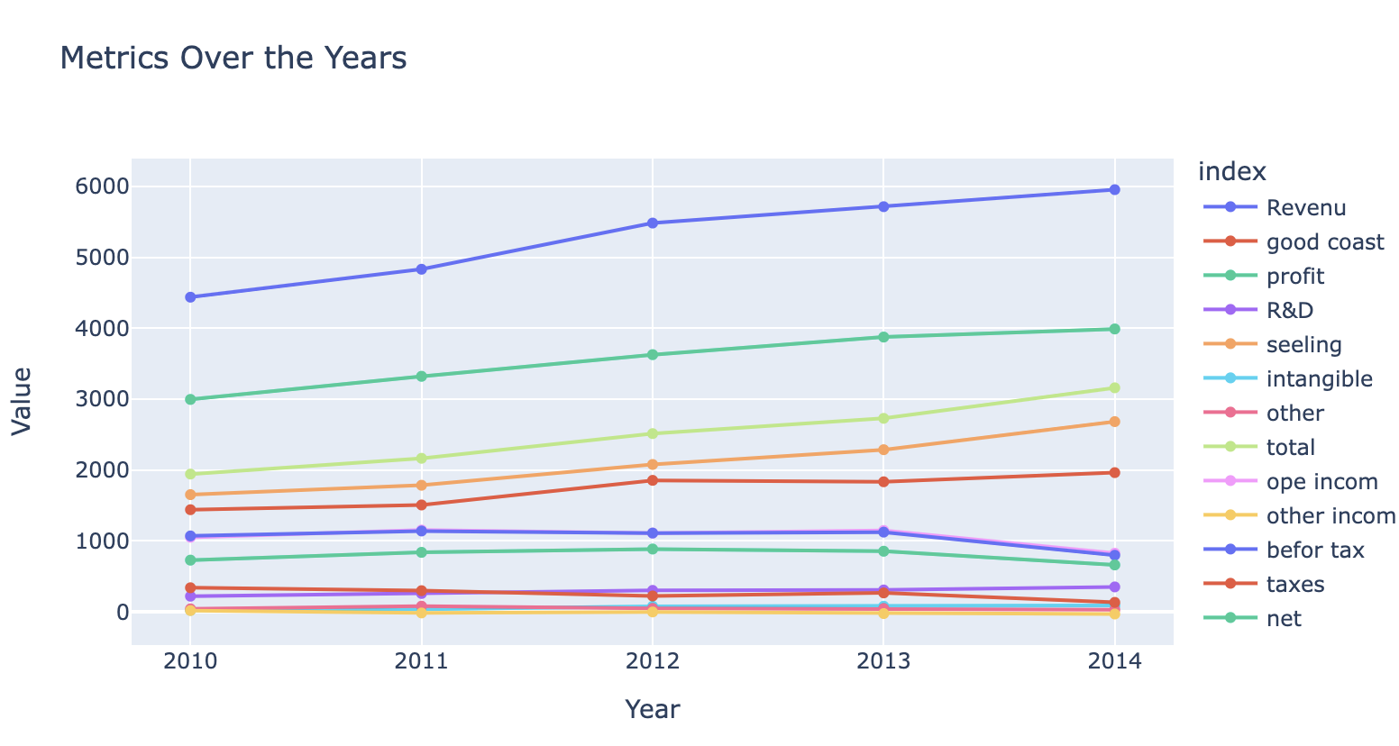
New Tax : lost of profile

Slide 6
Logical Precision
Each week, our facilities come alive as we manufacture over 7,200 goods, meticulously assembled in batches to ensure the highest quality. Our surgical kits, known for their complexity, contain hundreds of different parts, each playing a vital role in the success of surgical procedures. Despite the challenges in predicting the exact components needed for each case, our commitment to precision and quality remains unwavering.

Slide 7
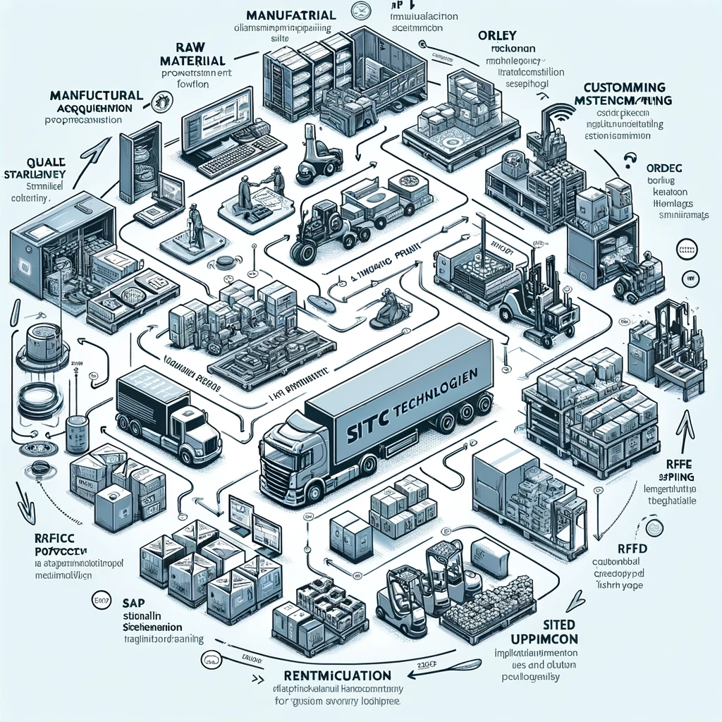

Slide 8
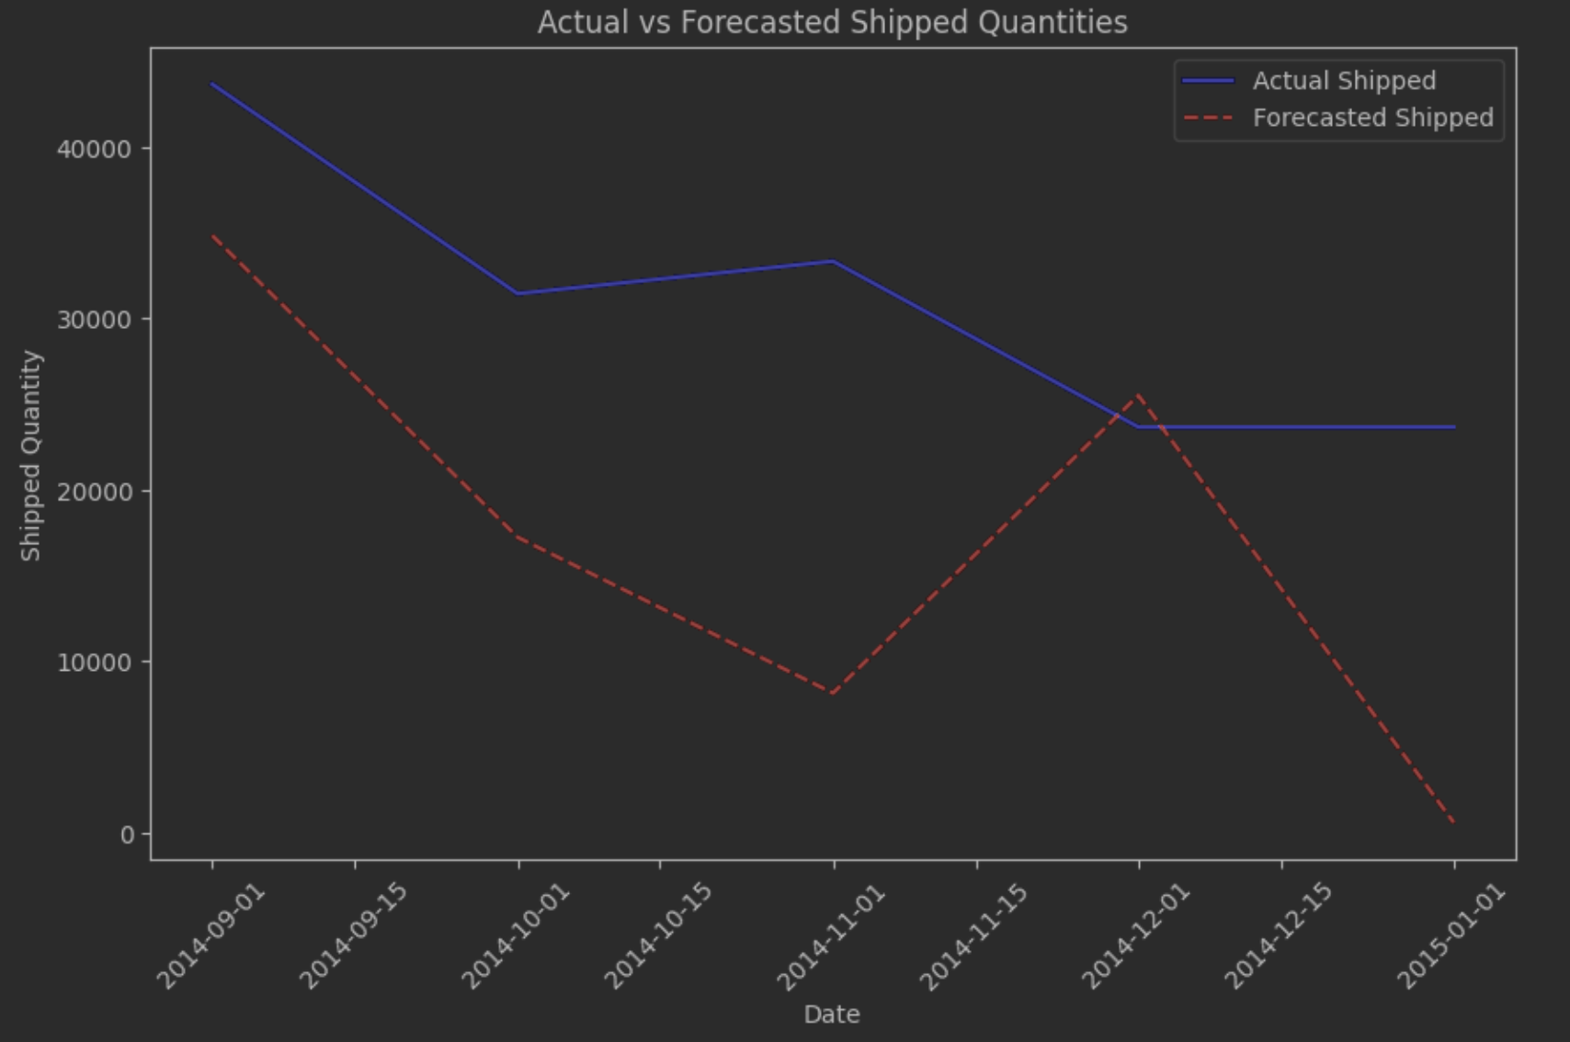
Forecasting Strategie

Slide 9
A robust Supply Chain
At the heart of our operations is a diverse and dynamic supply chain, encompassing manufacturers, surgical distributors, third-party logistics (3PL) companies, and hospitals. This intricate network ensures the seamless delivery of our medical devices to the locations where they are needed most.

Slide 10
Our Dedicated Team
Fueling our success is our dedicated sales team, whose expertise and passion drive our products into hospitals nationwide. With a competitive salary starting at $30,000 and the potential to exceed $100,000, our team is motivated to excel. However, recent legislative changes, including a new 2.3% tax on medical device revenues, present new challenges to our financial landscape, potentially impacting net earnings.

Slide 11
Solutions

Slide 12
Implement RFID Technology
Enhanced Traceability: By embedding RFID tags in our products, we can record the date and time of production for each specific item. This technology enables precise tracking, crucial for addressing any customer or hospital complaints efficiently.
Process Monitoring: The ability to easily track the entire manufacturing process through date and time identification not only improves product traceability but also enhances quality control and production planning.
Maintenance Scheduling: RFID data can facilitate predictive maintenance for our machinery, scheduling service based on actual usage rather than fixed intervals, thereby reducing downtime and extending equipment life.

Slide 13
Digital Sales and Education Platform
Removing Sales Representatives: Transitioning to a digital platform where the functions and benefits of our devices are clearly explained can significantly reduce the reliance on sales representatives. This approach allows for a more scalable and cost-effective method of educating and selling to hospitals.
Self-Service for Hospitals: Through this system, hospitals can access detailed product information, training materials, and support resources, enhancing their purchasing decisions and usage efficacy.

Slide 14
In-Site Sterilization Facility
Cost and Time Efficiency: Establishing an in-site sterilization process eliminates the need for off-site sterilization services, thereby saving on transportation costs and reducing the overall time from production to delivery.
Quality Control: An in-house sterilization process offers greater control over the quality and safety of the sterilization procedure, ensuring that all products meet the highest standards

Slide 15
Integration of Busniess inteligense suite
Streamlined Ordering: Implementing SAP software will revolutionize how orders are placed and managed. Hospitals can clearly specify their needs, including types of devices and delivery timelines, facilitating more efficient order processing and fulfillment.
Operational Visibility: SAP’s comprehensive tools provide visibility into every aspect of the supply chain, from inventory management to financial transactions, ensuring that resources are optimized and customer needs are met promptly.

Slide 16
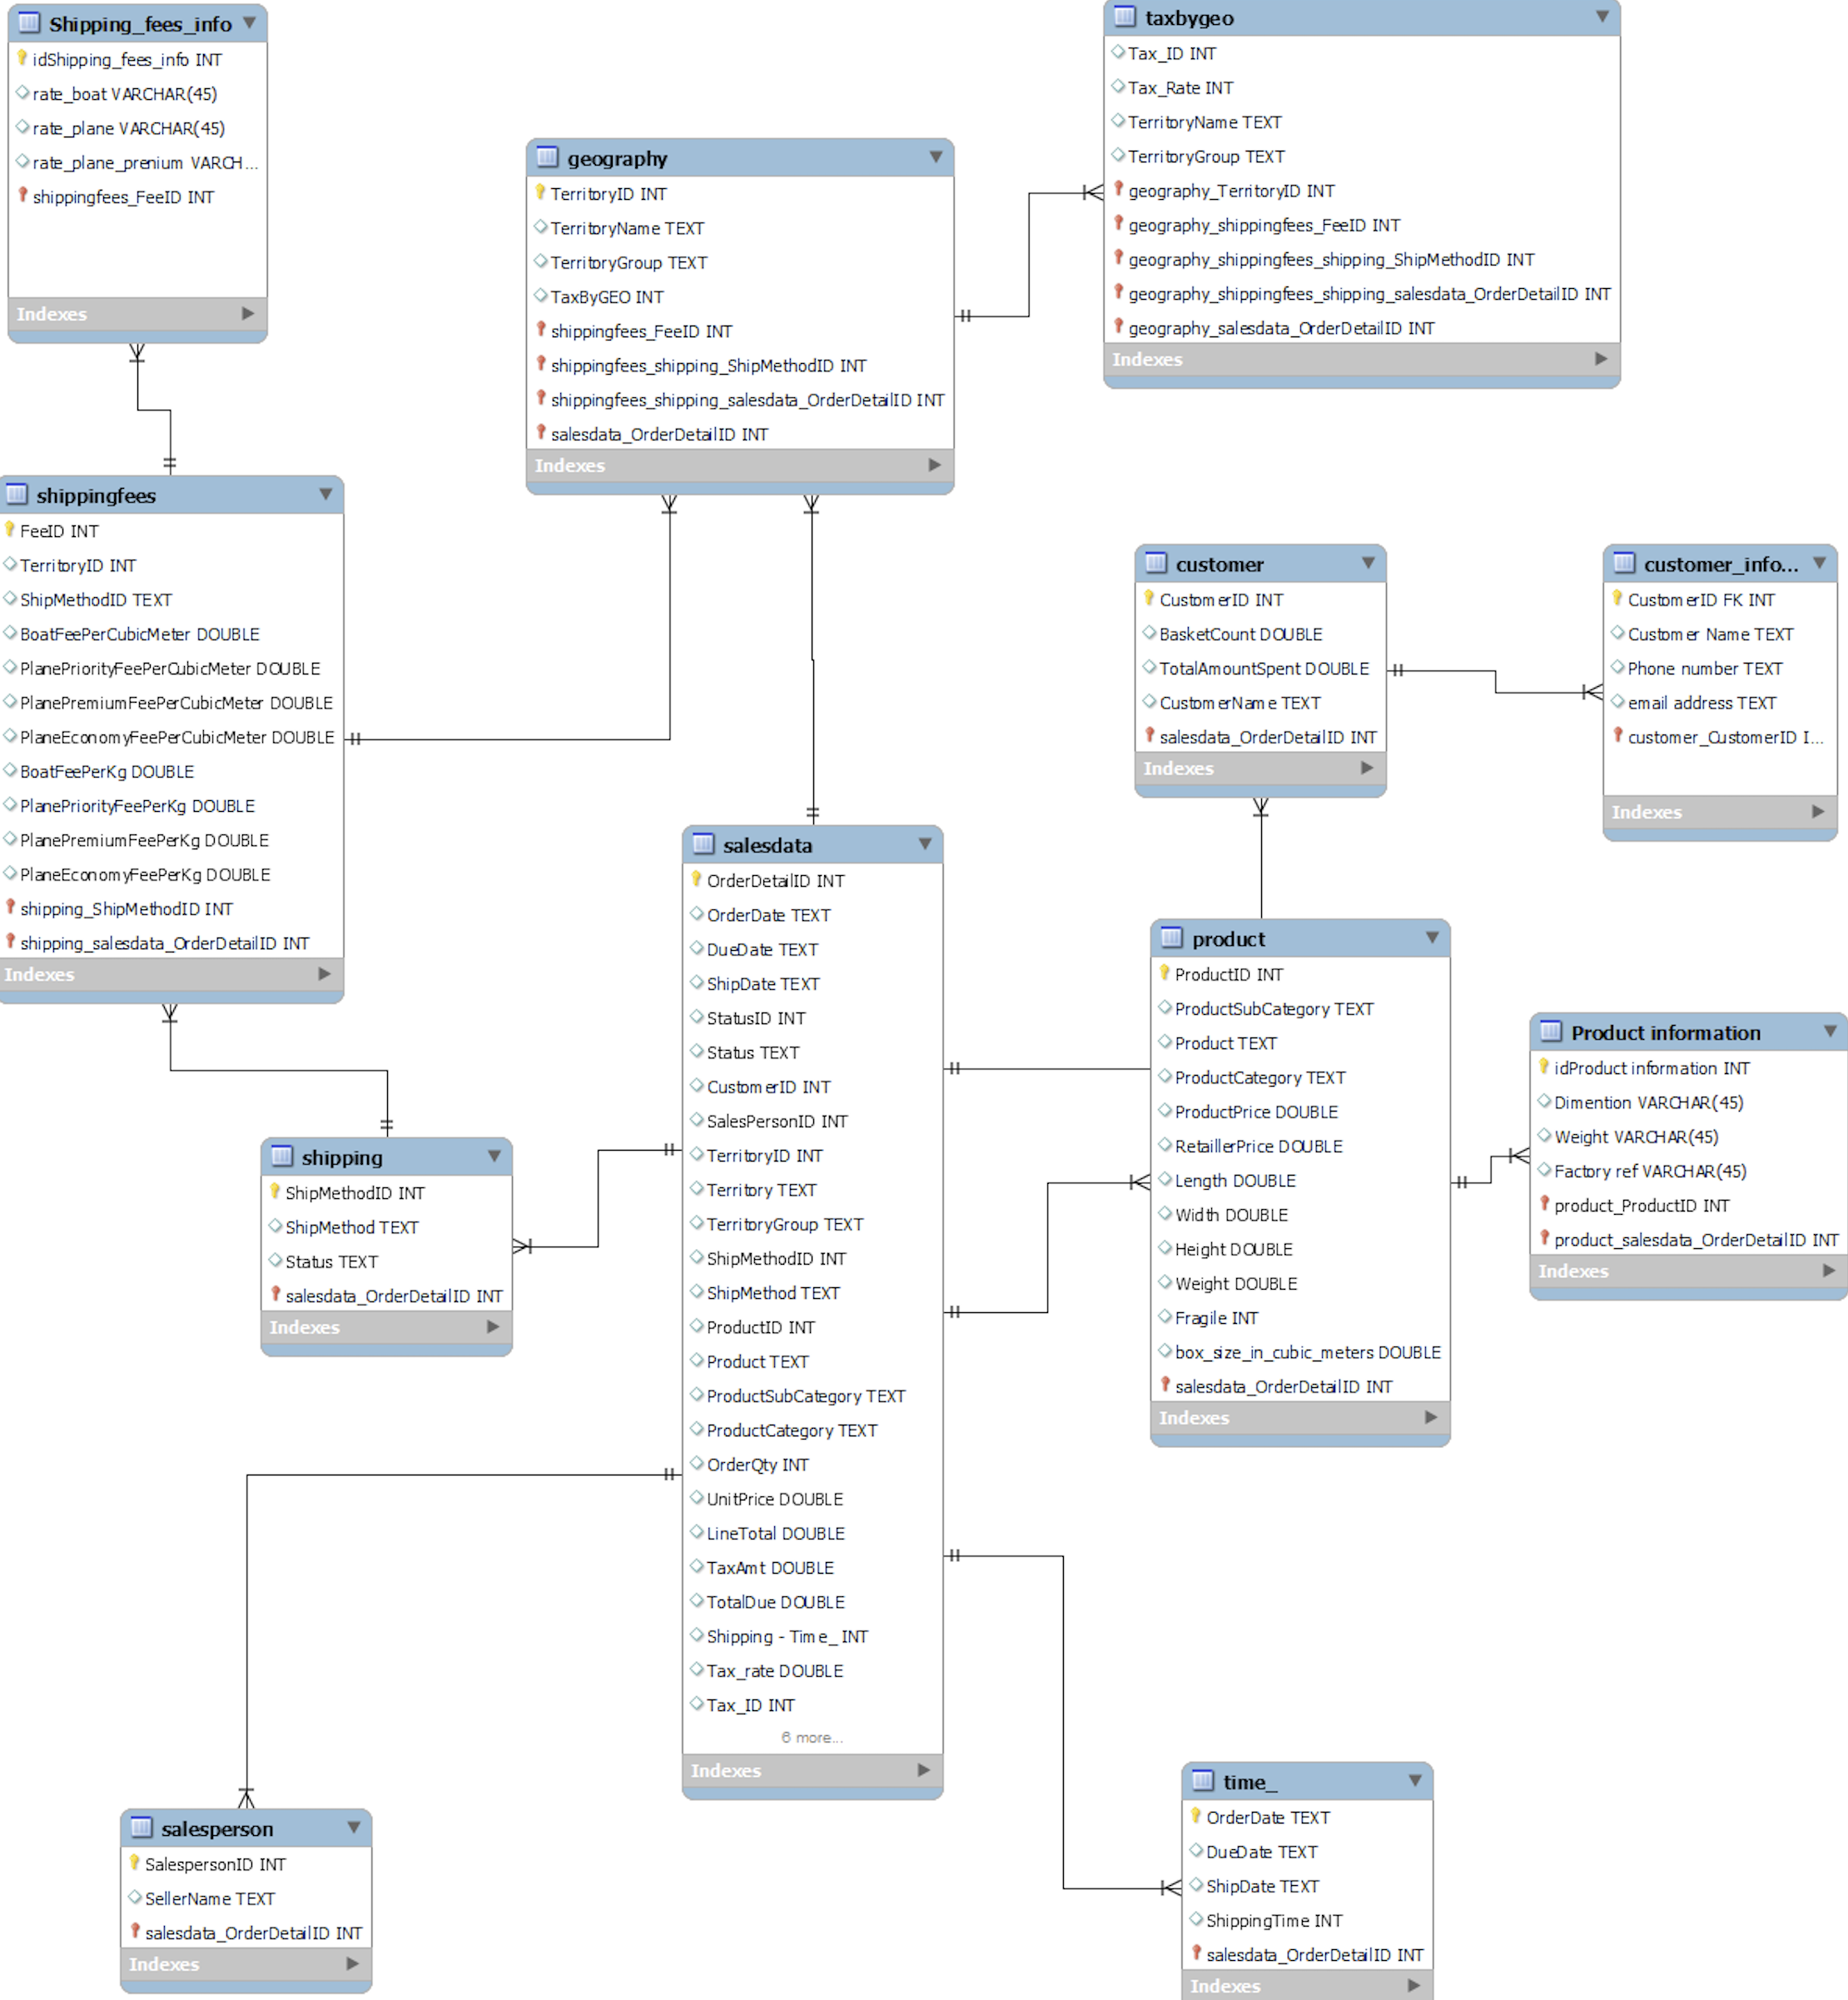
Propose Database schema for follow stock

Slide 17
Conclusion
As we navigate these challenges and opportunities, MTC Technologies Corporation remains committed to advancing medical technology and improving patient care through our innovative products and dedicated team.

